Slide 1
Custom Objects:
The Basics, Tips, and Tricks
Julie Workman
Director of Technology
jworkman@bluestarfam.org
@juliewworkman

Slide 2
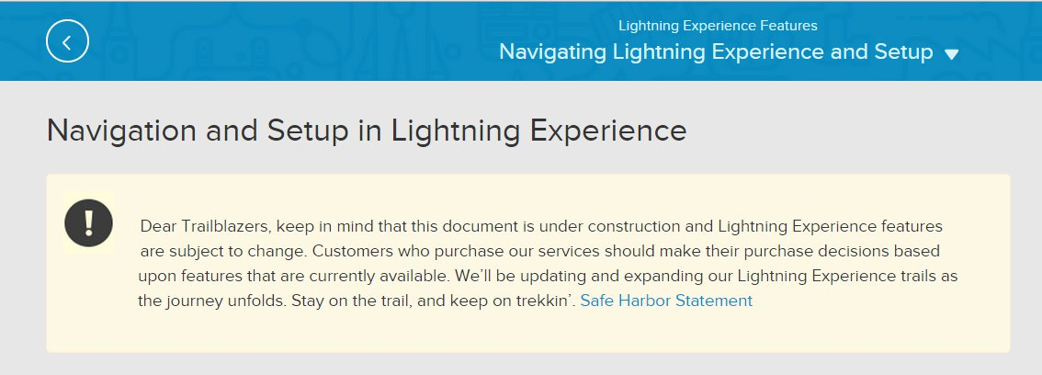
Safe Harbor
Safe harbor statement under the Private Securities Litigation Reform Act of 1995:
This presentation may contain forward-looking statements that involve risks, uncertainties, and assumptions. If any such uncertainties materialize or if any of the assumptions proves incorrect, the results of salesforce.com, inc. could differ materially from the results expressed or implied by the forward-looking statements we make. All statements other than statements of historical fact could be deemed forward-looking, including any projections of product or service availability, subscriber growth, earnings, revenues, or other financial items and any statements regarding strategies or plans of management for future operations, statements of belief, any statements concerning new, planned, or upgraded services or technology developments and customer contracts or use of our services.
The risks and uncertainties referred to above include – but are not limited to – risks associated with developing and delivering new functionality for our service, new products and services, our new business model, our past operating losses, possible fluctuations in our operating results and rate of growth, interruptions or delays in our Web hosting, breach of our security measures, the outcome of any litigation, risks associated with completed and any possible mergers and acquisitions, the immature market in which we operate, our relatively limited operating history, our ability to expand, retain, and motivate our employees and manage our growth, new releases of our service and successful customer deployment, our limited history reselling non-salesforce.com products, and utilization and selling to larger enterprise customers. Further information on potential factors that could affect the financial results of salesforce.com, inc. is included in our annual report on Form 10-K for the most recent fiscal year and in our quarterly report on Form 10-Q for the most recent fiscal quarter. These documents and others containing important disclosures are available on the SEC Filings section of the Investor Information section of our Web site.
Any unreleased services or features referenced in this or other presentations, press releases or public statements are not currently available and may not be delivered on time or at all. Customers who purchase our services should make the purchase decisions based upon features that are currently available. Salesforce.com, inc. assumes no obligation and does not intend to update these forward-looking statements.

Slide 3
Introductions

Slide 4
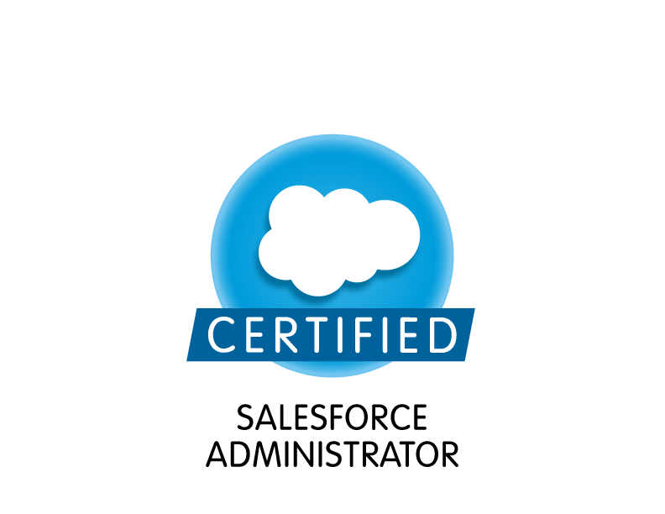
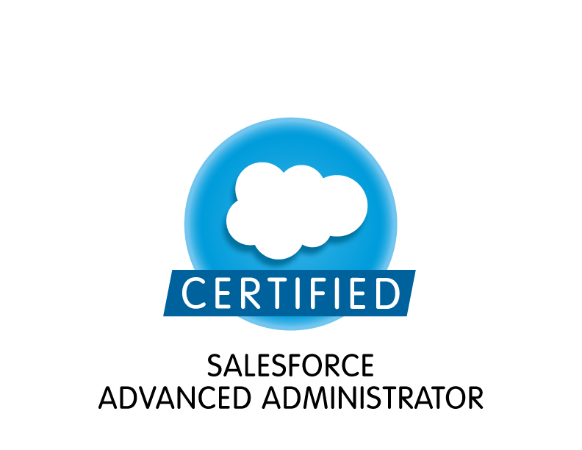



Julie Workman, MS
Director of Technology, Blue Star Families

Slide 5
Custom Object Takeaways
Unleash the power of custom objects with…
What are custom objects, really?
How to use Schema Builder to understand relationships and model new functionality
Understanding considerations when creating objects
Object Permissions and access
Best Practices

Slide 6

What are custom objects?

Slide 7

Why are Custom Objects so Awesome?
Your business needs are unique, complex, and changing
Custom objects connect the dots between data sets
Custom objects can drive user adoption
Flexibility in design

Slide 8
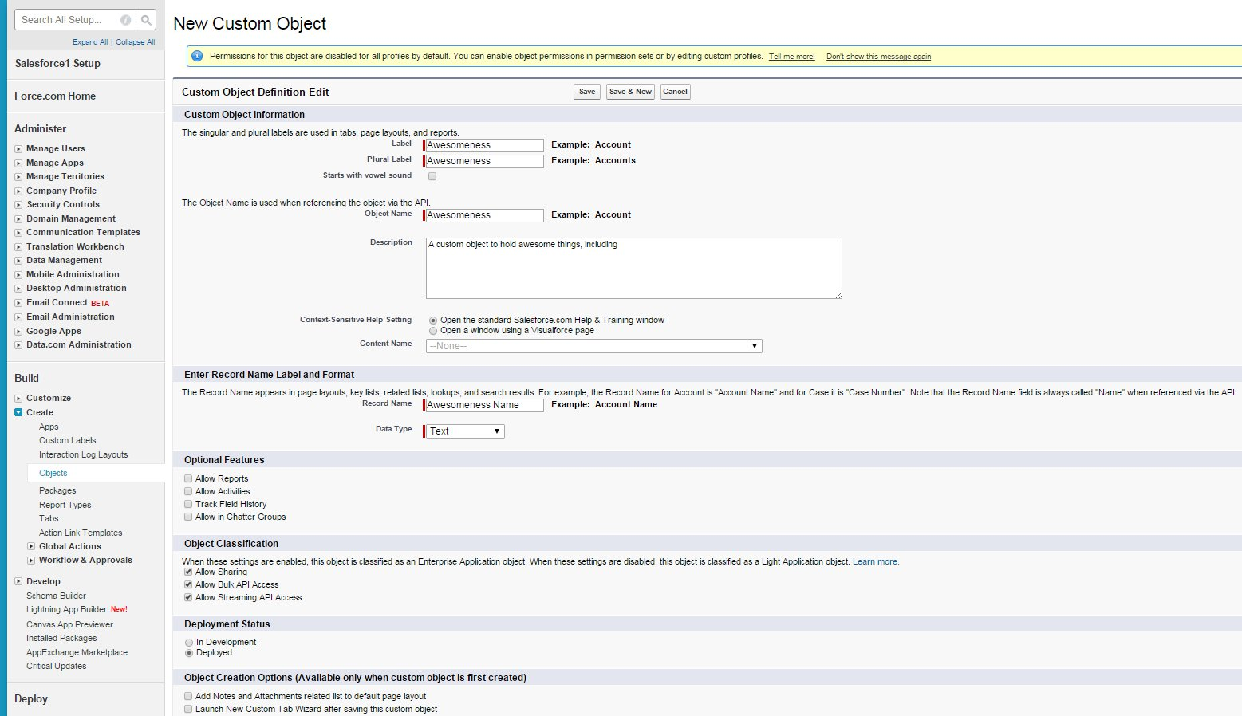
Use Build→ Create→ Objects
A step-by-step process to create new objects
Custom Object Definition Edit
Think through that Record Name Label and Format bit!

Slide 9
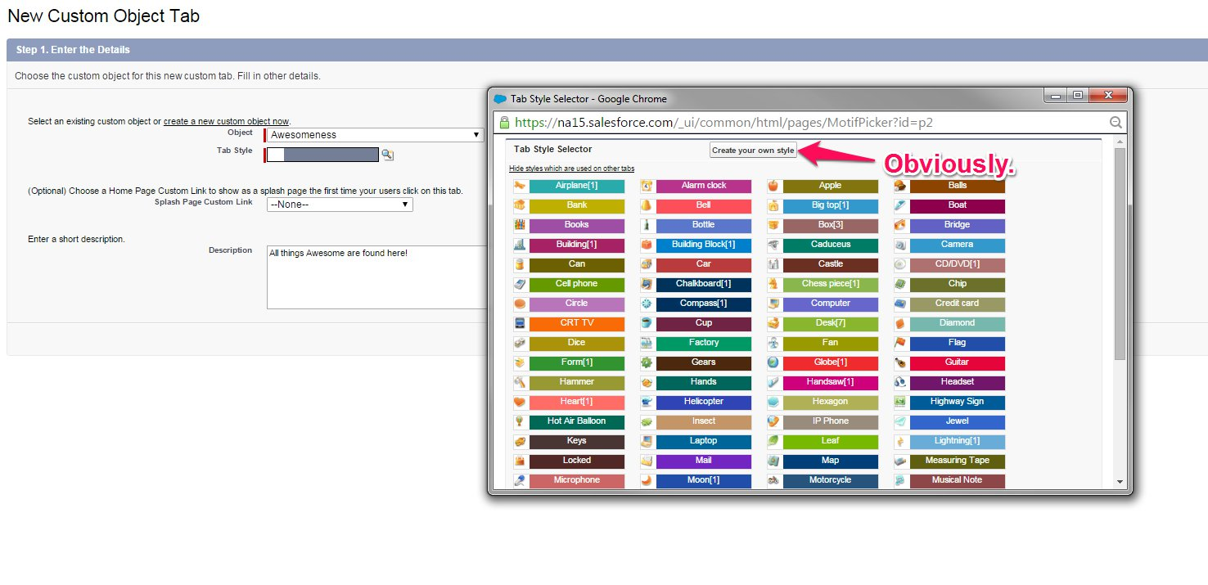
To Tab, or Not To Tab
Just how visible do you want the data in this object to be?
Consider…
Record creation capability, especially for “child” records
Search results, reporting, access
Use description fields always
Careful! Don’t “Include Tab” for every custom App!
Still to do: CRED permissions

Slide 10
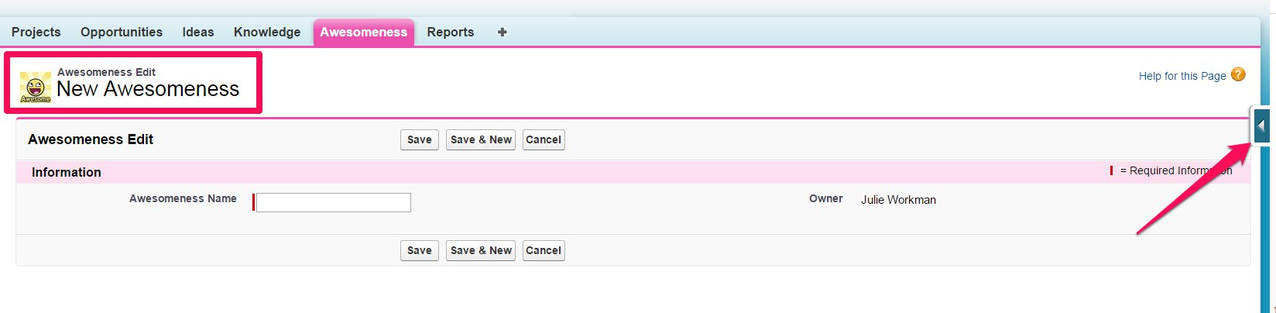
We have a Custom Object! Awesomeness!
What do we have at this point?
Standard Fields
Name Field
Audit Fields
Tab
Report type
Page Layout
You know about that Awesome blue rectangle, right?

Slide 11
Object Visibility
Will users see the new object?
Tabs: Go or no go?
    Search ability
    Visibility in Apps—consider including for parent objects
Apps: Include your tab in apps of interest
Permissions: When creating a new object, visibility depends on
    Enterprise, Unlimited, Performance, and Developer: depends on “View All Data” or “Modify All Data” disabled
    Contact Manager, Group, and Professional Editions: CRED permissions are enabled for all profiles
  Sharing: controlled by OWD
  Delegating Administration: to non-administrator owners
  Queues: distributing ownership of records
  Search: finding custom object records

Slide 12
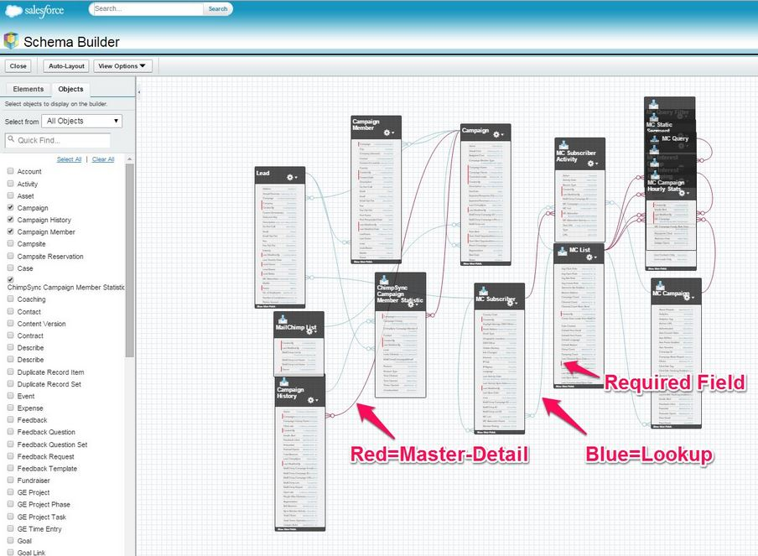
Use Schema Builder
Understand relationships and create/edit objects manually
Schema Builder is the visual display of your data model
(Setup→ Build→ Schema Builder)
Lean on your Sandboxes—create and model your solutions freely

Slide 13
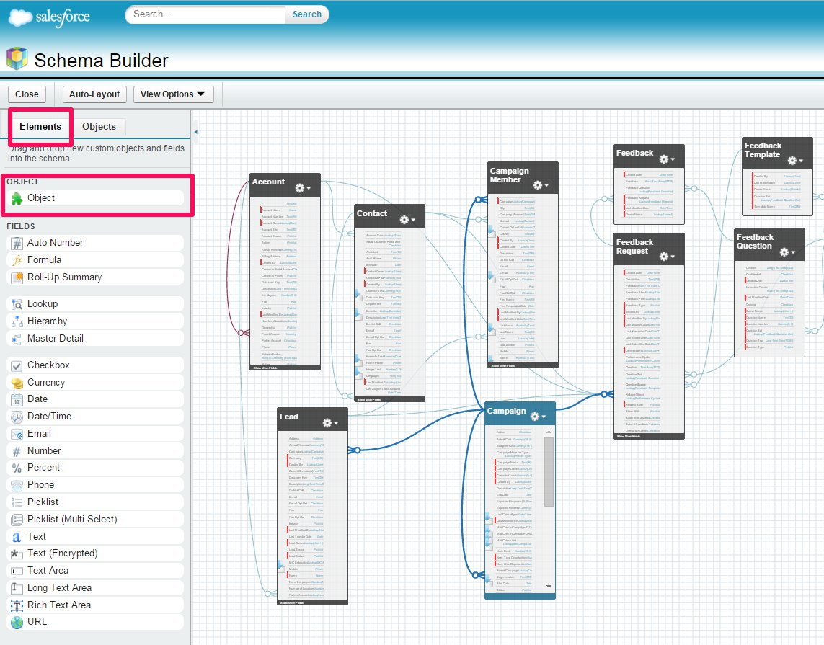
Creating Objects using Schema Builder
Almost too easy…
Toggle between Objects and Elements

Slide 14
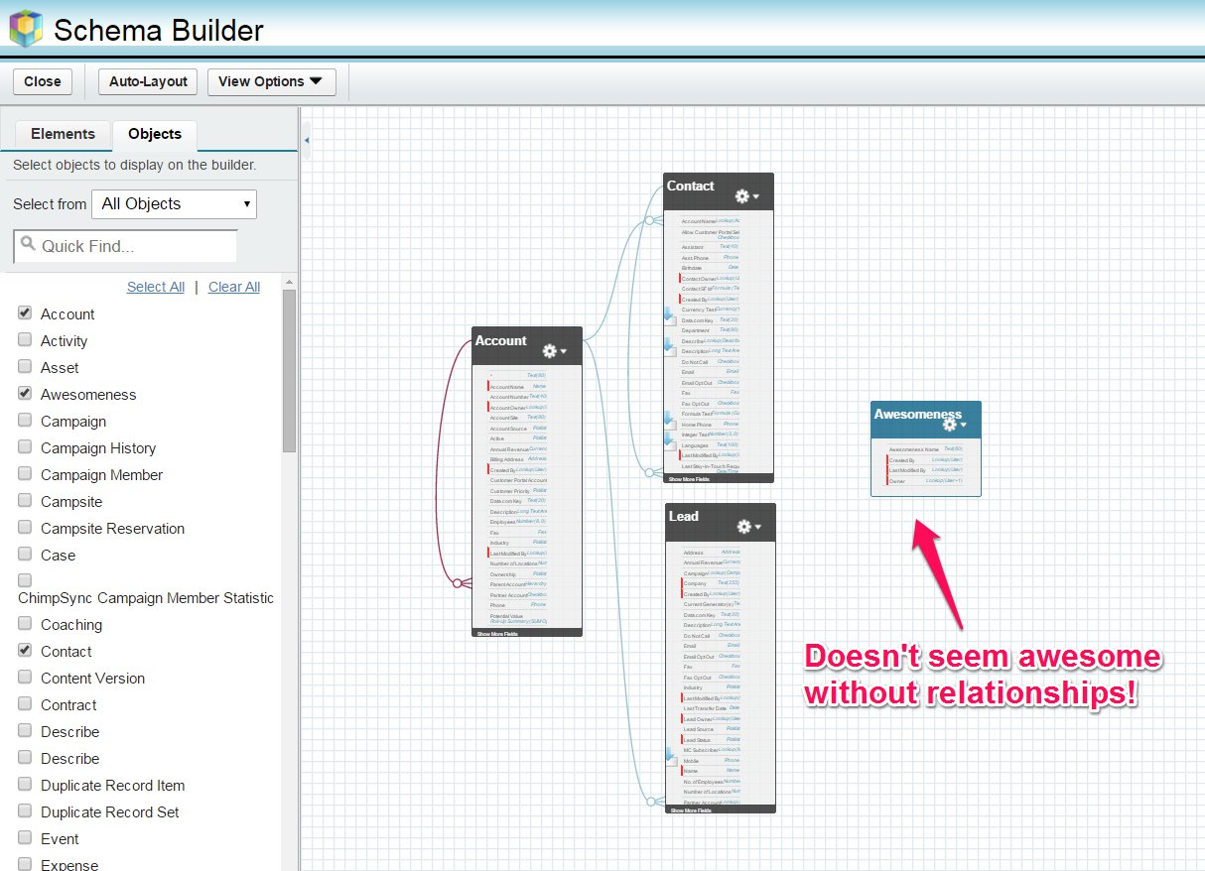
Model and Understand Relationships
Relationships demonstrate the flow of data across objects
De-clutter your view using Clear All
Isolate objects of interest
View, modify relationships and fields using Elements

Slide 15
Object Configuration
Don’t stop yet!
Review Object level permissions and access
Field History Tracking
Chatter Feed tracking
Reporting
Data import
Ongoing data quality management

Slide 16

Best Practices
Keep your org out of Spaghetti Junction!
-Spaghetti Junction by Rhodes Rumsey

Slide 17
Best Practices
How to avoid Spaghetti Junction
Good governance is key to maintaining org health.
Create object-level help
Use multiple developer orgs to model functionality
Consistency is Key

