Slide 1
The Road to Becoming a
Connected Nonprofit
Julie Workman
Director of Technology, Engagement and Marketing at Blue Star Families
jworkman@bluestarfam.org
@juliewworkman

Slide 2
Safe Harbor
Safe harbor statement under the Private Securities Litigation Reform Act of 1995:
This presentation may contain forward-looking statements that involve risks, uncertainties, and assumptions. If any such uncertainties materialize or if any of the assumptions proves incorrect, the results of salesforce.com, inc. could differ materially from the results expressed or implied by the forward-looking statements we make. All statements other than statements of historical fact could be deemed forward-looking, including any projections of product or service availability, subscriber growth, earnings, revenues, or other financial items and any statements regarding strategies or plans of management for future operations, statements of belief, any statements concerning new, planned, or upgraded services or technology developments and customer contracts or use of our services.
The risks and uncertainties referred to above include – but are not limited to – risks associated with developing and delivering new functionality for our service, new products and services, our new business model, our past operating losses, possible fluctuations in our operating results and rate of growth, interruptions or delays in our Web hosting, breach of our security measures, the outcome of any litigation, risks associated with completed and any possible mergers and acquisitions, the immature market in which we operate, our relatively limited operating history, our ability to expand, retain, and motivate our employees and manage our growth, new releases of our service and successful customer deployment, our limited history reselling non-salesforce.com products, and utilization and selling to larger enterprise customers. Further information on potential factors that could affect the financial results of salesforce.com, inc. is included in our annual report on Form 10-K for the most recent fiscal year and in our quarterly report on Form 10-Q for the most recent fiscal quarter. These documents and others containing important disclosures are available on the SEC Filings section of the Investor Information section of our Web site.
Any unreleased services or features referenced in this or other presentations, press releases or public statements are not currently available and may not be delivered on time or at all. Customers who purchase our services should make the purchase decisions based upon features that are currently available. Salesforce.com, inc. assumes no obligation and does not intend to update these forward-looking statements.
Notes:
Key Takeaway:
We are a publicly traded company. Please make your buying decisions only on the products commercially available from Salesforce.
Talk Track:
Before I begin, just a quick note that when considering future developments, whether by us or with any other solution provider, you should always base your purchasing decisions on what is currently available.

Slide 3
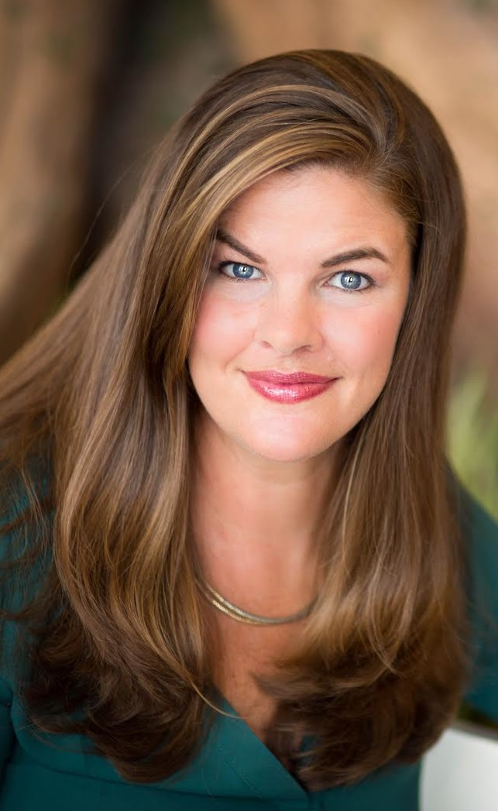

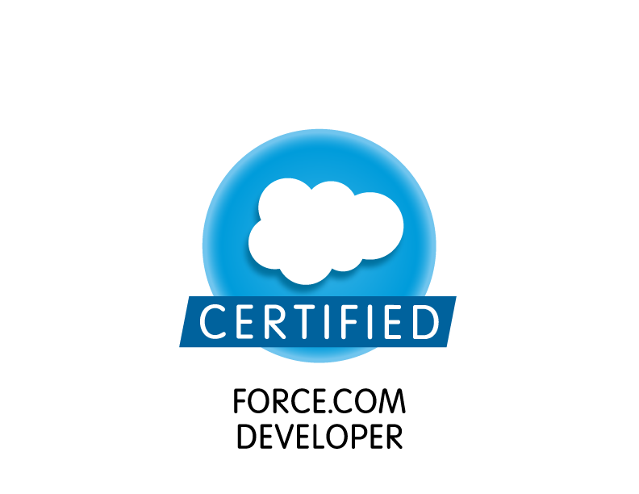


Becoming a Connected Nonprofit
Julie Workman, MS
Director of Technology, Engagement and Marketing
Blue Star Families
jworkman@bluestarfam.org
@juliewworkman

Slide 4
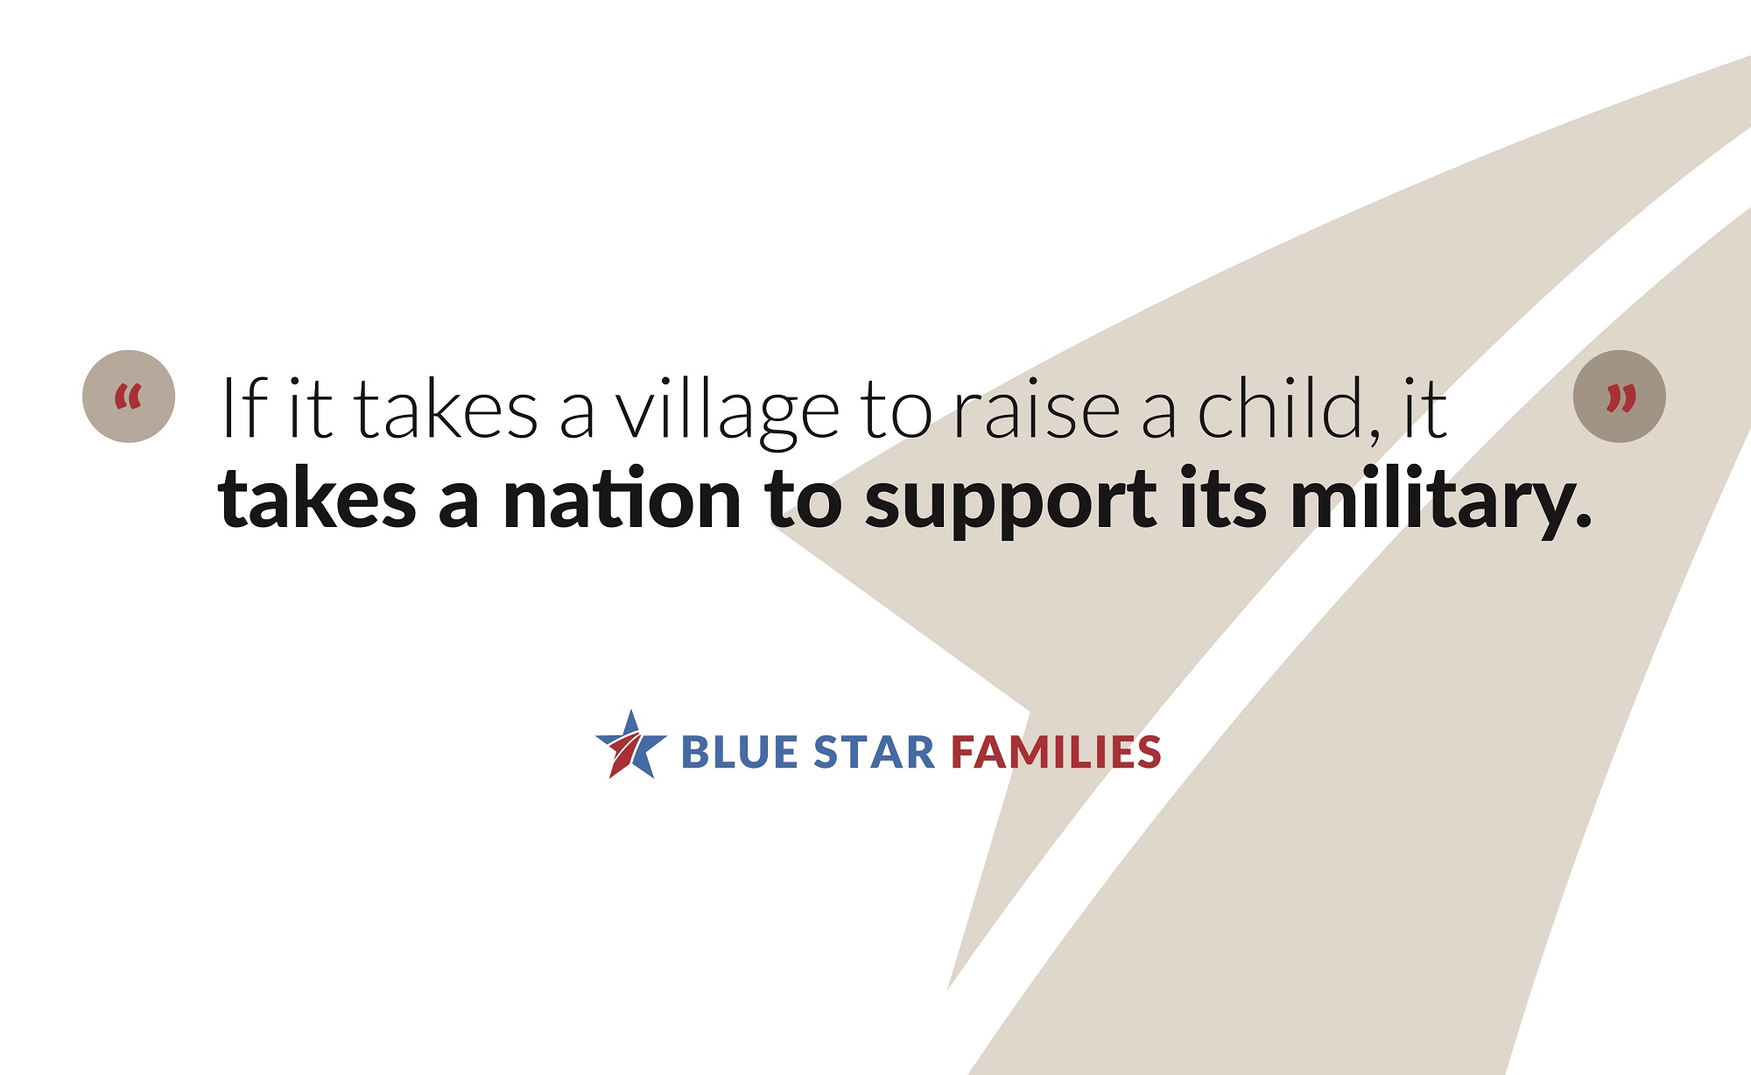
Subtitle placeholder

Slide 5
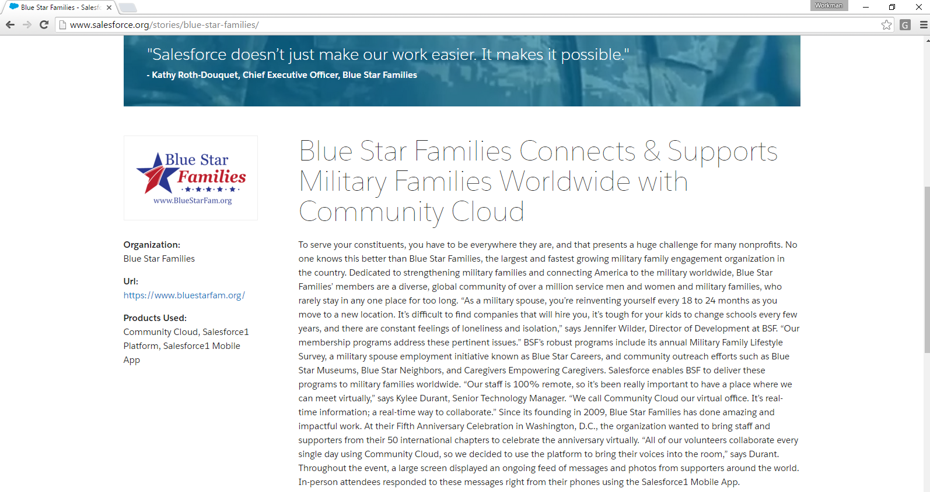
Salesforce Brings It All Together
We’re wherever military families are—as an organization and as a team
Sales Cloud/CRM adoption from the beginning
Creates a key “Source of Truth” for multiple potential sources of information
Worth the resource investment for scalability and long-term growth

Slide 6










Blue Star Families Runs on Salesforce
Sales Cloud, Marketing Cloud, Community Cloud
Sales
Community
Marketing

Slide 7

Kelley Babbs
Technology Manager,
Blue Star Families

Slide 8
Key Integrations
We’re pretty protective, so they have to be *really* good
Form Assembly
  How we move most data into Salesforce, even sometimes for licensed users
  Allows us to add complicated sets of records very quickly
Click & Pledge
  Processing donations and (free) event registration---very sophisticated product that does a lot
Map Anything
  Chapter-based organization: immensely helpful in creating campaigns and reports based on location
Box.com
  Creates unified view of information
  BSF Resource objects: photos, marketing materials, key organizational data
  Massive lift to transition from prior Enterprise File Management (EFM)

Slide 9
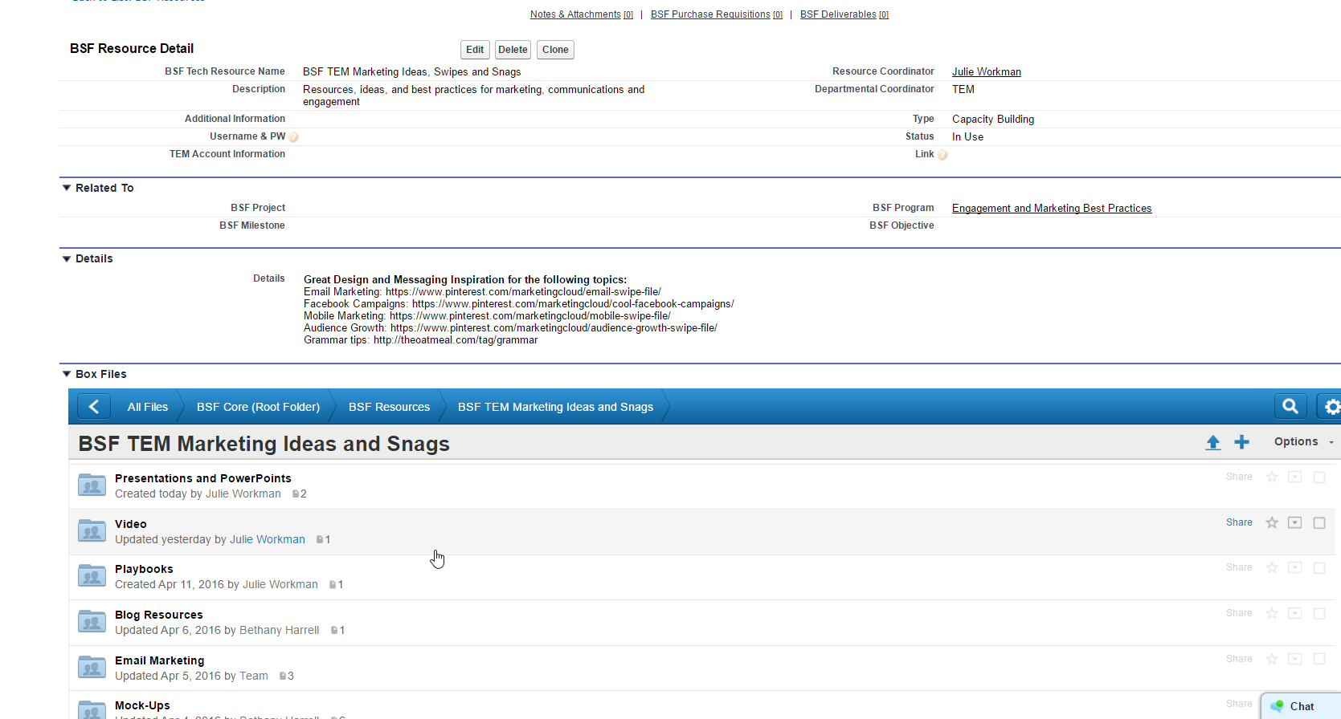

Box.com Integration
Box integration on custom and standard objects
Scalable data storage & waterfall permissions
Can be shared with collaborators outside of our organization
Configuration requires some basic Apex and advanced admin skills
File migration is way harder!

Slide 10
Bana Miller
Communications Manager
Valerie Nicholas
Technology Fellow

Slide 11
Project Management Toolkit
Projects, Milestones, Deliverables
  Based on global standards of project management
  Connect to Opportunities, creates collaboration
  Sharing restricts visibility—can even share projects with outside consultants
Interactions
  Connects meeting notes, ideas, and conversations to standard objects and/or PMTK
  Key Indicators, Lessons Learned
  Next Steps: Automation and Streamlining
  Create more fluid user experience
  Creating template projects for “Supercloning”

Slide 12
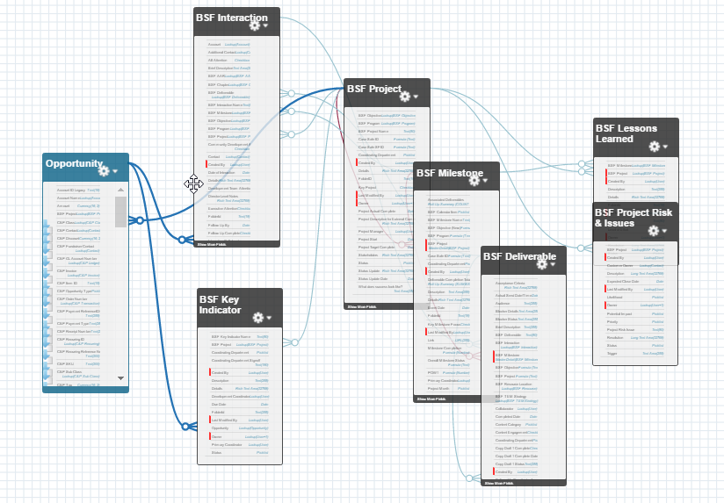
ERD for PMTK
Use Schema Builder to rapidly prototype solutions
Model functionality in sandbox
Test and deploy in production
Iterate

Slide 13
Customization for Specific Organizational Needs
Community Development
  Chapters, membership, and local connections
  Event tracking, impact analysis
Development
  Extension of custom Opportunities object
Operations
  Approval processes on leave requests and budget expenditures
  Resources and training materials
Policy, Partnerships, and Program Evaluation
  Special functionality: Blue Star SpouseForce

Slide 14
Amy Bontrager
Blue Star Careers Program Manager

Slide 15

Blue Star SpouseForce
Providing Military Spouses career building in Salesforce Administration
Pilot Program in partnership with Clinton Foundation
Specifically geared to needs of military spouses
8-week training program + wraparound support for learners
Supported by Salesforce Community Cloud “Hub” for students to connect, share resources, and leverage learning

Slide 16
Bethany Harrell
Engagement and Brand Marketing Manager
Jenny Felsen
Digital Platform Manager
Diana Tsai
Website Superhero Team Lead

Slide 17

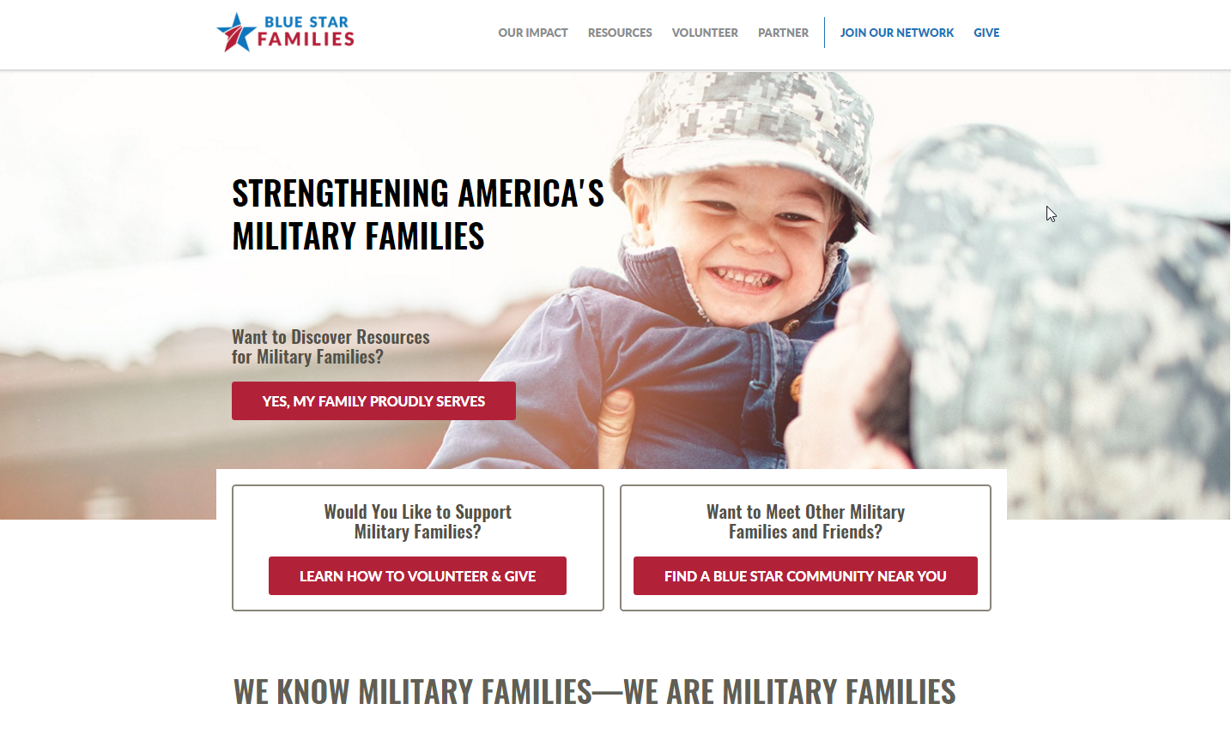

Website Integrations
Data from WordPress CMS to Salesforce CRM
Key element: creating “user paths”
GetFeedback quiz collects intelligent information and passes as a Lead
Gravity Forms for email gates
Click & Pledge for donations
Intercom for web interactions
Our favorite: Form Assembly for everything we possibly can!

Slide 18
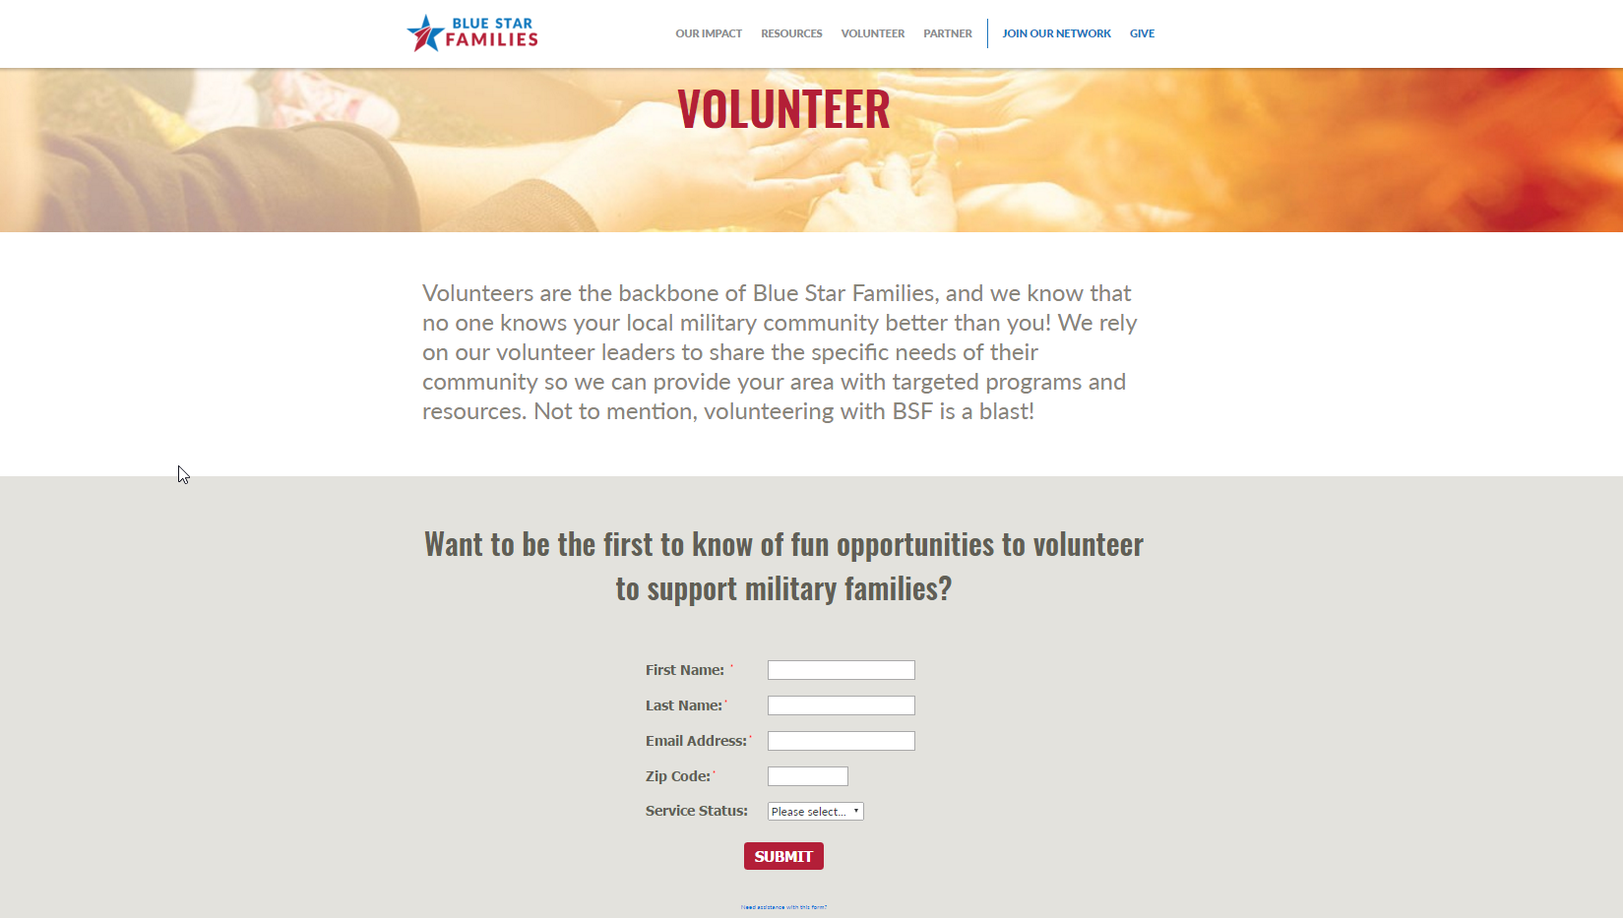
Volunteer Page: Case Study
Engaging interested volunteers across channels
Form Assembly “short form” to capture initial information
Redirect to a thank you page with longer form (Form Assembly) and email contact
Creates Contact and custom Volunteer Interest records in CRM
Kicks off a welcome series from Marketing Cloud, leveraging Automation Studio, inviting the potential volunteer to complete onboarding process

Slide 19

Engaging Constituents and Analyzing Data…Good Times!
A/B Testing
We tested send days and times
We tested graphic and text rich content
We analyzed the results to increase our newsletter open rate
Automated Drip Campaigns
Import data via Salesforce reports and data extensions
A simple process to engage with different constituents
Staff workload is streamlined by the automation
Dynamic Content
Our members live all over the world
Dynamic content blocks allow us to communicate in relevant ways
We can send one email with geo specific information

Slide 20
Amanda Moore
Member Engagement Manager,
Blue Star Families
Social Studio Guru-In-Training

Slide 21
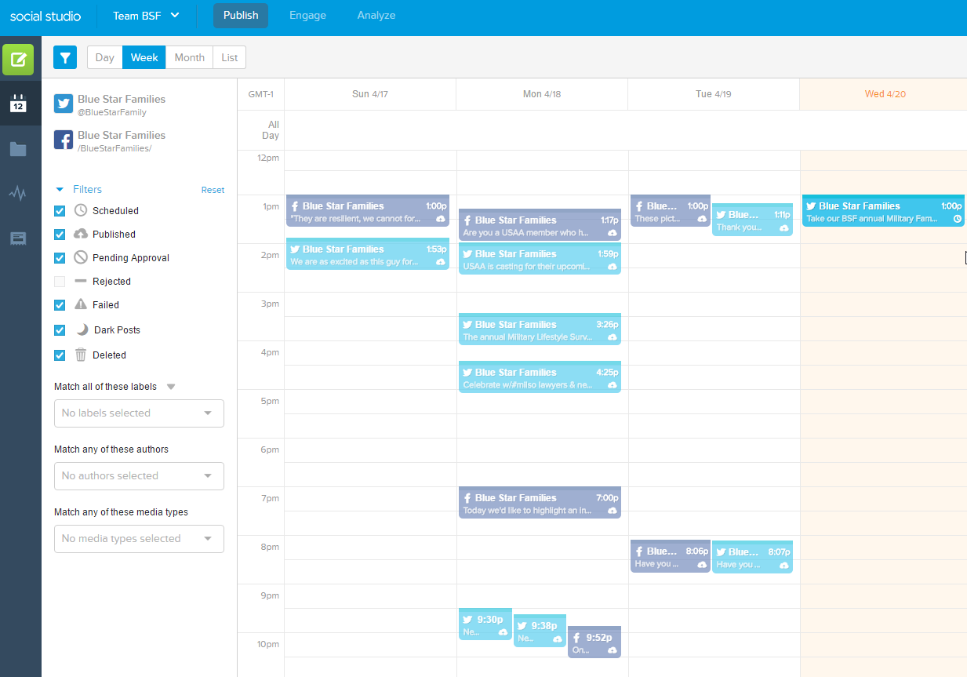
Social Studio
Newest tool in our toolkit
BSF member demographics make this tool important!
Key point for our use case: Macros that create CRM Contact records from social interactions

Slide 22
We <3 Salesforce.org

Slide 23
Top 3 Reasons BSF LOVES Salesforce.org
We REALLY love Salesforce.org
1. Best AE
2. Dreamforce & Training for Nonprofits/Higher Education
3. The 1-1-1 Model (Read the SSIR article!)

Slide 24
Keys to Success
Sharing what works… and what hasn’t (yet!)

Slide 25
Keys to Success
What has worked really well… and what hasn’t
Configuring native deduplication tools: WIN
Custom builds using biweekly sprints: WIN
Weekly data export: WIN
Calendaring in Salesforce: working on it…
Enterprise file sharing migration: needed a LOT more resources

Slide 26
Keys to Success: User Support
What has worked really well… and what hasn’t
Friday Tech Hour: WIN
Morning Minute videos: WIN
Chatter: Big WIN (for most!)
Trailhead Challenge: WIN/In progress
Documentation: In progress
Super User Group (Center of Excellence)… we’re calling version 1.0 “complete”

Slide 27
Development Roadmap

Slide 28


